Slide 1

Computer Graphics
Week 6 : Midpoint (Ellipse)

Slide 2
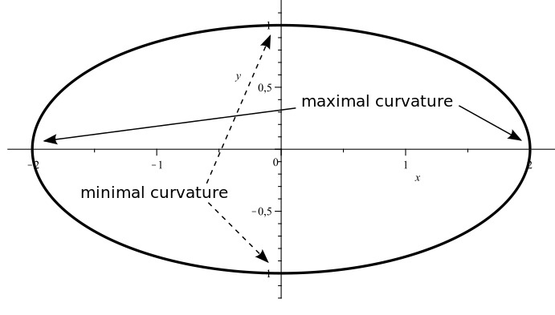
Ellipse
A modified circle whose radius varies from a maximum value in one direction (major axis) to a minimum value in the perpendicular direction (minor axis).

Slide 3
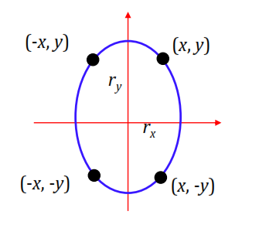
Ellipse Algorithms
Symmetry between quadrants
Not symmetric between the two octants of a quadrant
Thus, we must calculate pixel positions along the elliptical arc through one quadrant and then we obtain positions in the remaining 3 quadrants by symmetry

Slide 4
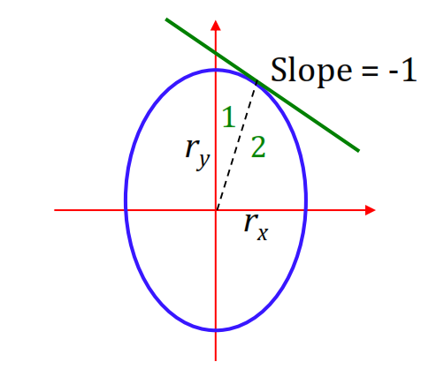
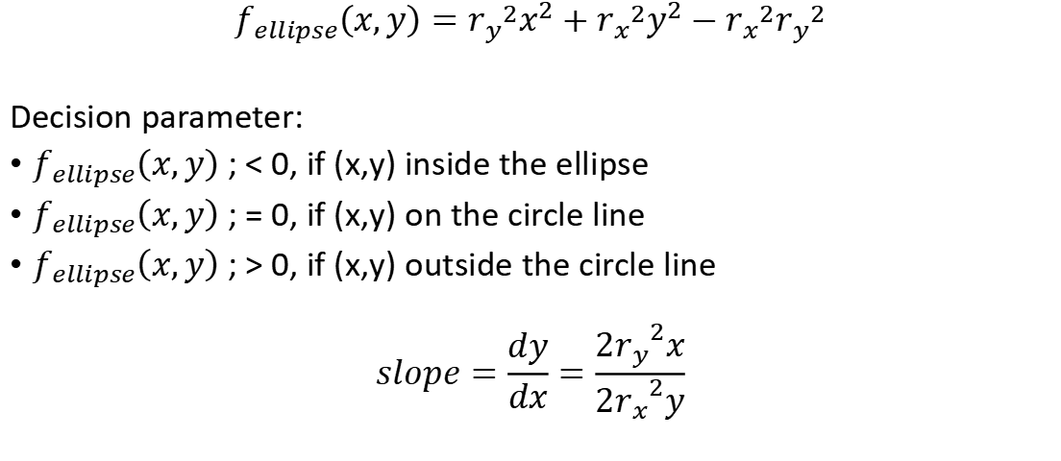
Ellipse Algorithms
$$f_{ellipse}\left(x,y\right)={r_{y}}^{2}x^{2}+{r_{x}}^{2}y^{2}−{r_{x}}^{2}{r_{y}}^{2}$$
Decision parameter:
$f_{ellipse}\left(x,y\right)$ ; < 0, if (x,y) inside the ellipse
$f_{ellipse}\left(x,y\right)$ ; = 0, if (x,y) on the circle line
$f_{ellipse}\left(x,y\right)$ ; > 0, if (x,y) outside the circle line
$$slope=\frac{dy}{dx}=\frac{{{2r}_{y}}^{2}x}{{{2r}_{x}}^{2}y}$$

Slide 5
Decision Parameter

Slide 6
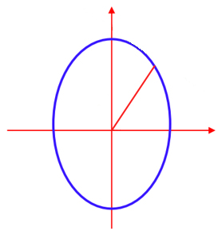
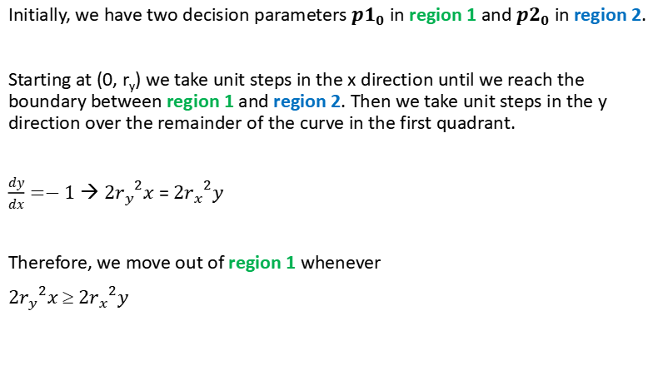
Ellipse Algorithms
Initially, we have two decision parameters ${p1}_{0}$ in region 1 and ${p2}_{0}$ in region 2.
Starting at (0, r_{y}) we take unit steps in the x direction until we reach the boundary between region 1 and region 2. Then we take unit steps in the y direction over the remainder of the curve in the first quadrant.
$\frac{dy}{dx}=−1$ → ${{2r}_{y}}^{2}x$ = ${{2r}_{x}}^{2}y$
Therefore, we move out of region 1 whenever
${{2r}_{y}}^{2}x$ ≥ ${{2r}_{x}}^{2}y$
Region 1
Region 2
(-x,y)
(x,y)
(-x,-y)
(x,-y)

Slide 7
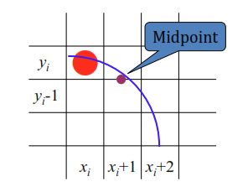

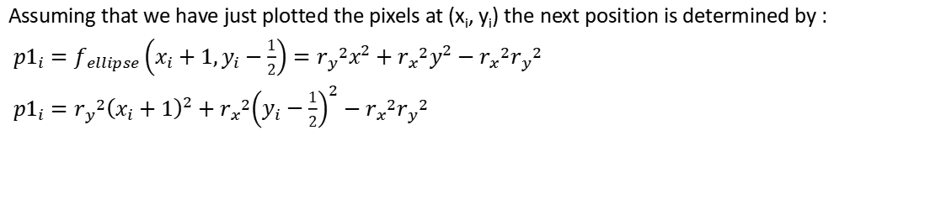
Decision Parameter (Region 1)
Assuming that we have just plotted the pixels at (x_{i}, y_{i}) the next position is determined by :
${p1}_{i}=f_{ellipse}\left(x_{i}+1,y_{i}−\frac{1}{2}\right)={r_{y}}^{2}x^{2}+{r_{x}}^{2}y^{2}−{r_{x}}^{2}{r_{y}}^{2}$
${p1}_{i}={r_{y}}^{2}{\left(x_{i}+1\right)}^{2}+{r_{x}}^{2}{\left(y_{i}−\frac{1}{2}\right)}^{2}−{r_{x}}^{2}{r_{y}}^{2}$
If ${p1}_{i}  0$ the midpoint is inside the ellipse → $y_{i}$ is closer
If ${p1}_{i} \text{≥} 0$ the midpoint is outside the ellipse → $y_{i}−1$ is closer

Slide 8

Decision Parameter (Region 1)
At the next position $\left[x_{i+1}+1=x_{i}+2\right]$
${p1}_{i+1}=f_{ellipse}\left(x_{i+1}+1,y_{i+1}−\frac{1}{2}\right)={r_{y}}^{2}{\left(x_{i}+2\right)}^{2}+{r_{x}}^{2}{\left(y_{i+1}−\frac{1}{2}\right)}^{2}−{r_{x}}^{2}{r_{y}}^{2}$
or
${p1}_{i+1}={p1}_{i}+2{r_{y}}^{2}{\left(x_{i}+1\right)}^{2}+{r_{y}}^{2}+{r_{x}}^{2}\left[{\left(y_{i+1}−\frac{1}{2}\right)}^{2}−{\left(y_{i}−\frac{1}{2}\right)}^{2}\right]$
where $y_{i+1}=y_{i}$
or $y_{i+1}=y_{i}−1$

Slide 9

Decision Parameter (Region 1)
Decision parameters are incremented by:
$increment=\left\{\begin{aligned}2{r_{y}}^{2}x_{i+1}+{r_{y}}^{2} \\ 2{r_{y}}^{2}x_{i+1}+{r_{y}}^{2}−2{r_{x}}^{2}y_{i+1}\end{aligned} \begin{matrix}if {p1}_{i}<0 \\ if{ p1}_{i}≥0\end{matrix}\right.$
Use only addition and substraction by obtaining $2{r_{y}}^{2}x$ and $2{r_{x}}^{2}y$
At initial position (0, $r_{y}$)
$2{r_{y}}^{2}x=0$
$2{r_{x}}^{2}y=2{r_{x}}^{2}r_{y}$
${p1}_{0}=f_{ellipse}\left(1,r_{y}−\frac{1}{2}\right)={r_{y}}^{2}+{r_{x}}^{2}{\left(r_{y}−\frac{1}{2}\right)}^{2}−{r_{x}}^{2}{r_{y}}^{2}$
${p1}_{0}={r_{y}}^{2}−{r_{x}}^{2}r_{y}+\frac{1}{4}{r_{x}}^{2}$

Slide 10
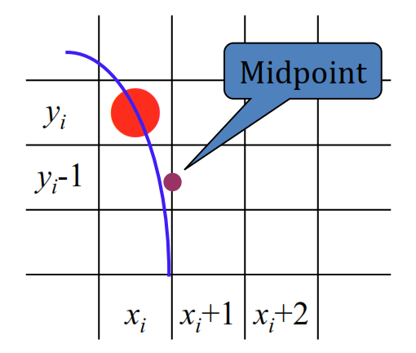
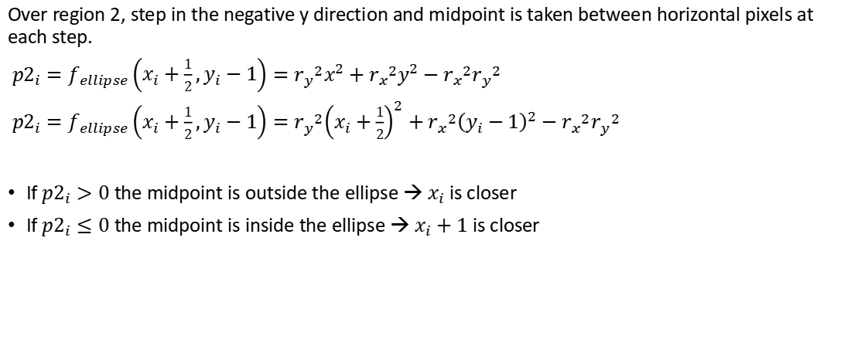
Decision Parameter (Region 2)
Over region 2, step in the negative y direction and midpoint is taken between horizontal pixels at each step.
${p2}_{i}=f_{ellipse}\left(x_{i}+\frac{1}{2},y_{i}−1\right)={r_{y}}^{2}x^{2}+{r_{x}}^{2}y^{2}−{r_{x}}^{2}{r_{y}}^{2}$
${p2}_{i}=f_{ellipse}\left(x_{i}+\frac{1}{2},y_{i}−1\right)={r_{y}}^{2}{\left(x_{i}+\frac{1}{2}\right)}^{2}+{r_{x}}^{2}{\left(y_{i}−1\right)}^{2}−{r_{x}}^{2}{r_{y}}^{2}$
If ${p2}_{i}>0$ the midpoint is outside the ellipse → $x_{i}$ is closer
If ${p2}_{i}≤0$ the midpoint is inside the ellipse → $x_{i}+1$ is closer

Slide 11

Decision Parameter (Region 2)
At the next position $\left[y_{i+1}−1=y_{i}−2\right]$
${p2}_{i+1}=f_{ellipse}\left(x_{i+1}+\frac{1}{2},y_{i+1}−1\right)={r_{y}}^{2}{\left(x_{i+1}+\frac{1}{2}\right)}^{2}+{r_{x}}^{2}{\left(y_{i}−2\right)}^{2}−{r_{x}}^{2}{r_{y}}^{2}$
or
${p2}_{i+1}={p2}_{i}+2{r_{x}}^{2}{\left(y_{i}−1\right)}^{2}+{r_{x}}^{2}+{r_{y}}^{2}\left[{\left(x_{i+1}+\frac{1}{2}\right)}^{2}−{\left(x_{i}+\frac{1}{2}\right)}^{2}\right]$
where $x_{i+1}=x_{i}$
or $x_{i+1}=x_{i}+1$

Slide 12
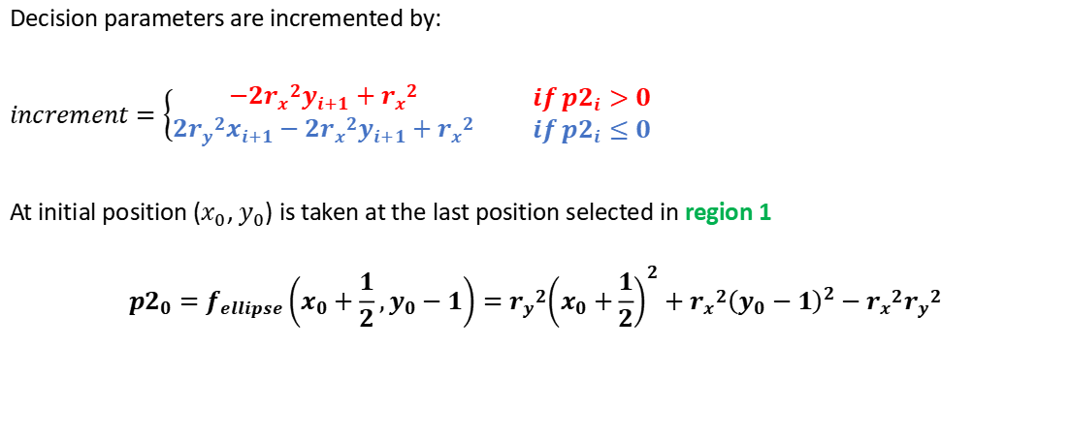
Decision Parameter (Region 2)
Decision parameters are incremented by:
$increment=\left\{\begin{aligned}−2{r_{x}}^{2}y_{i+1}+{r_{x}}^{2} \\ 2{r_{y}}^{2}x_{i+1}−2{r_{x}}^{2}y_{i+1}+{r_{x}}^{2}\end{aligned} \begin{matrix}if{ p2}_{i}>0 \\ if{ p2}_{i}≤0\end{matrix}\right.$
At initial position ($x_{0}$, $y_{0}$) is taken at the last position selected in region 1
$${p2}_{0}=f_{ellipse}\left(x_{0}+\frac{1}{2},y_{0}−1\right)={r_{y}}^{2}{\left(x_{0}+\frac{1}{2}\right)}^{2}+{r_{x}}^{2}{\left(y_{0}−1\right)}^{2}−{r_{x}}^{2}{r_{y}}^{2}$$

Slide 13
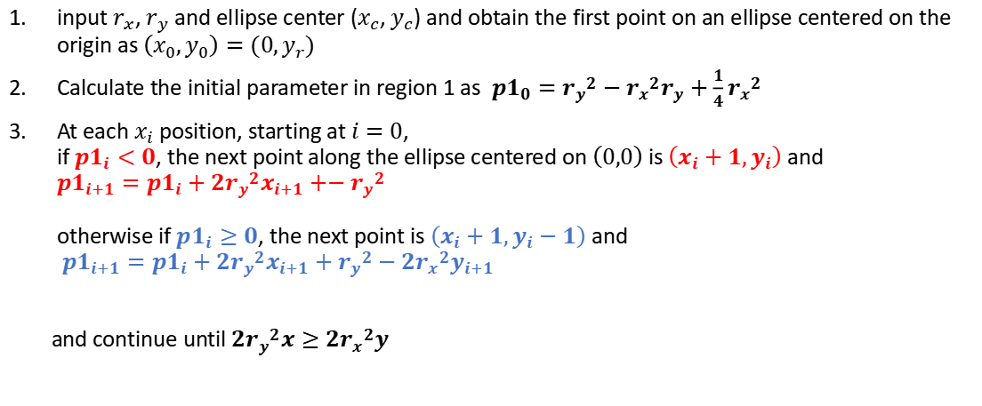
Midpoint Ellipse Algorithm
input $r_{x}$, $r_{y}$ and ellipse center ($x_{c}$, $y_{c}$) and obtain the first point on an ellipse centered on the origin as $\left(x_{0},y_{0}\right)=(0,y_{r})$
Calculate the initial parameter in region 1 as ${p1}_{0}={r_{y}}^{2}−{r_{x}}^{2}r_{y}+\frac{1}{4}{r_{x}}^{2}$
At each $x_{i}$ position, starting at $i=0$, if ${p1}_{i}<0$, the next point along the ellipse centered on $\left(0,0\right)$ is $\left(x_{i}+1,y_{i}\right)$ and ${p1}_{i+1}={p1}_{i}+2{r_{y}}^{2}x_{i+1}+−{r_{y}}^{2}$ otherwise if ${p1}_{i}≥0$, the next point is $\left(x_{i}+1,y_{i}−1\right)$ and ${p1}_{i+1}={p1}_{i}+2{r_{y}}^{2}x_{i+1}+{r_{y}}^{2}−2{r_{x}}^{2}y_{i+1}$
and continue until $2{r_{y}}^{2}x≥2{r_{x}}^{2}y$

Slide 14
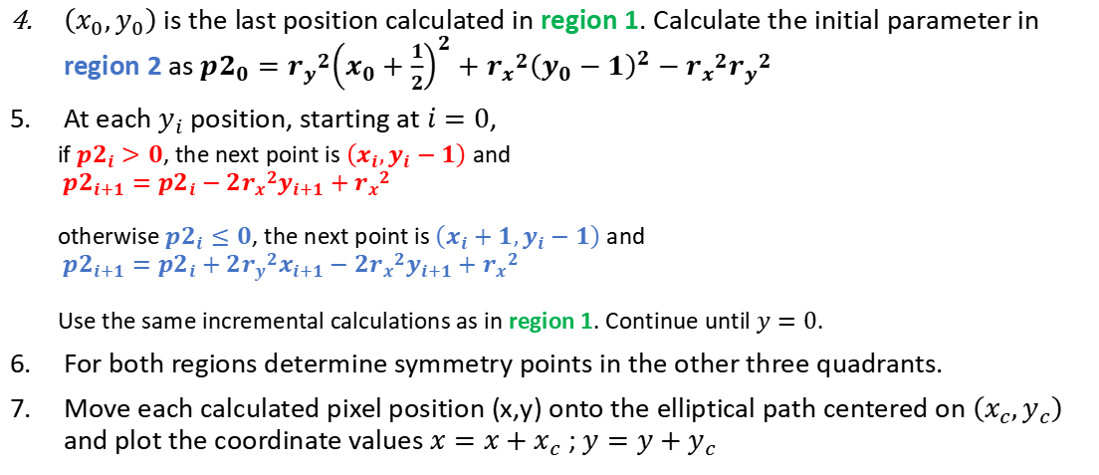
Midpoint Ellipse Algorithm (2)
$\left(x_{0},y_{0}\right)$ is the last position calculated in region 1. Calculate the initial parameter in region 2 as ${p2}_{0}={r_{y}}^{2}{\left(x_{0}+\frac{1}{2}\right)}^{2}+{r_{x}}^{2}{\left(y_{0}−1\right)}^{2}−{r_{x}}^{2}{r_{y}}^{2}$
At each $y_{i}$ position, starting at $i=0$,
if ${p2}_{i}>0$, the next point is $\left(x_{i},y_{i}−1\right)$ and ${p2}_{i+1}={p2}_{i}−2{r_{x}}^{2}y_{i+1}+{r_{x}}^{2}$ otherwise ${p2}_{i}≤0$, the next point is $\left(x_{i}+1,y_{i}−1\right)$ and ${p2}_{i+1}={p2}_{i}+2{r_{y}}^{2}x_{i+1}−2{r_{x}}^{2}y_{i+1}+{r_{x}}^{2}$ Use the same incremental calculations as in region 1. Continue until $y=0$.
For both regions determine symmetry points in the other three quadrants.
Move each calculated pixel position (x,y) onto the elliptical path centered on $\left(x_{c},y_{c}\right)$ and plot the coordinate values $x=x+x_{c}$ ; $y=y+y_{c}$

Slide 15
EXERCISE

Slide 16
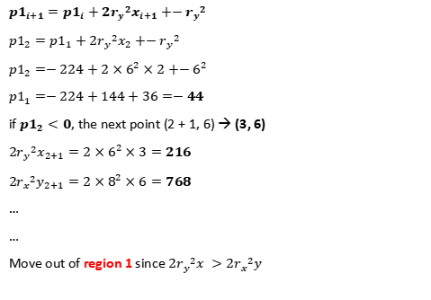
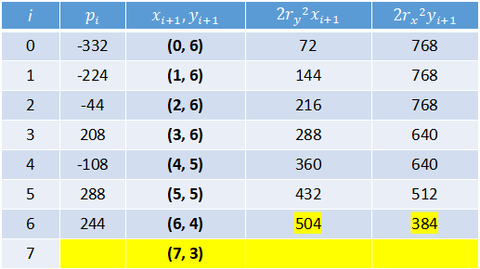
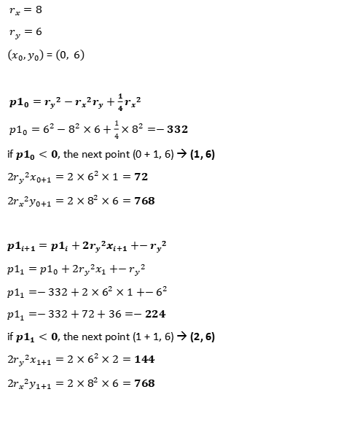
REGION 1
$r_{x}=8$
$r_{y}=6$
$\left(x_{0},y_{0}\right)$ = $\left(0, 6\right)$
${p1}_{0}={r_{y}}^{2}−{r_{x}}^{2}r_{y}+\frac{1}{4}{r_{x}}^{2}$
${p1}_{0}=6^{2}−8^{2}×6+\frac{1}{4}×8^{2}=−332$
if ${p1}_{0}<0$, the next point (0 + 1, 6) → (1, 6)
$2{r_{y}}^{2}x_{0+1}=2×6^{2}×1=72$
$2{r_{x}}^{2}y_{0+1}=2×8^{2}×6=768$
${p1}_{i+1}={p1}_{i}+2{r_{y}}^{2}x_{i+1}+−{r_{y}}^{2}$
${p1}_{1}={p1}_{0}+2{r_{y}}^{2}x_{1}+−{r_{y}}^{2}$
${p1}_{1}=−332+2×6^{2}×1+−6^{2}$
${p1}_{1}=−332+72+36=−224$
if ${p1}_{1}<0$, the next point (1 + 1, 6) → (2, 6)
$2{r_{y}}^{2}x_{1+1}=2×6^{2}×2=144$
$2{r_{x}}^{2}y_{1+1}=2×8^{2}×6=768$
${p1}_{i+1}={p1}_{i}+2{r_{y}}^{2}x_{i+1}+−{r_{y}}^{2}$
${p1}_{2}={p1}_{1}+2{r_{y}}^{2}x_{2}+−{r_{y}}^{2}$
${p1}_{2}=−224+2×6^{2}×2+−6^{2}$
${p1}_{1}=−224+144+36=−44$
if ${p1}_{2}<0$, the next point (2 + 1, 6) → (3, 6)
$2{r_{y}}^{2}x_{2+1}=2×6^{2}×3=216$
$2{r_{x}}^{2}y_{2+1}=2×8^{2}×6=768$
…
…
Move out of region 1 since $2{r_{y}}^{2}x >2{r_{x}}^{2}y$
i | $$p_{i}$$ | $$x_{i+1},y_{i+1}$$ | $$2{r_{y}}^{2}x_{i+1}$$ | $$2{r_{x}}^{2}y_{i+1}$$
0 | -332 | (0, 6) | 72 | 768
1 | -224 | (1, 6) | 144 | 768
2 | -44 | (2, 6) | 216 | 768
3 | 208 | (3, 6) | 288 | 640
4 | -108 | (4, 5) | 360 | 640
5 | 288 | (5, 5) | 432 | 512
6 | 244 | (6, 4) | 504 | 384
7 |  | (7, 3)
Notes:
36 – 384 + 16

Slide 17
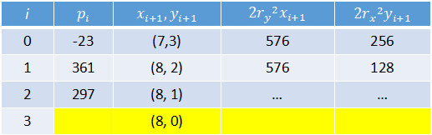
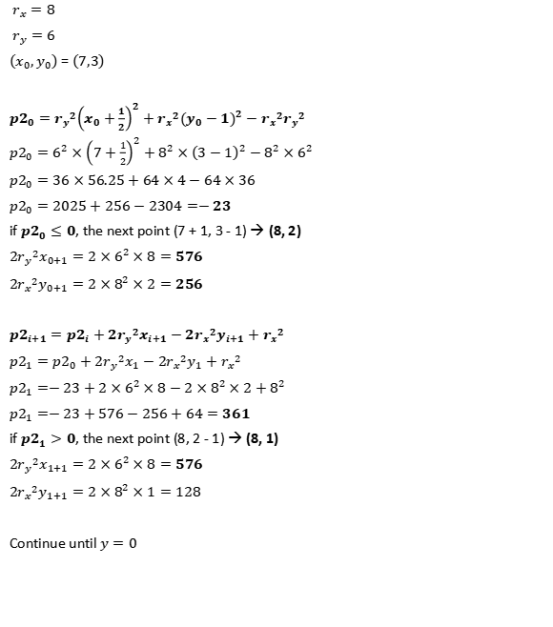
i | $$p_{i}$$ | $$x_{i+1},y_{i+1}$$ | $$2{r_{y}}^{2}x_{i+1}$$ | $$2{r_{x}}^{2}y_{i+1}$$
0 | -23 | (7,3) | 576 | 256
1 | 361 | (8, 2) | 576 | 128
2 | 297 | (8, 1) | … | …
3 |  | (8, 0)
REGION 2
$r_{x}=8$
$r_{y}=6$
$\left(x_{0},y_{0}\right)$ = $\left(7,3\right)$
${p2}_{0}={r_{y}}^{2}{\left(x_{0}+\frac{1}{2}\right)}^{2}+{r_{x}}^{2}{\left(y_{0}−1\right)}^{2}−{r_{x}}^{2}{r_{y}}^{2}$
${p2}_{0}=6^{2}×{\left(7+\frac{1}{2}\right)}^{2}+8^{2}×{\left(3−1\right)}^{2}−8^{2}×6^{2}$
${p2}_{0}=36×56.25+64×4−64×36$
${p2}_{0}=2025+256−2304=−23$
if ${p2}_{0}≤0$, the next point (7 + 1, 3 - 1) → (8, 2)
$2{r_{y}}^{2}x_{0+1}=2×6^{2}×8=576$
$2{r_{x}}^{2}y_{0+1}=2×8^{2}×2=256$
${p2}_{i+1}={p2}_{i}+2{r_{y}}^{2}x_{i+1}−2{r_{x}}^{2}y_{i+1}+{r_{x}}^{2}$
${p2}_{1}={p2}_{0}+2{r_{y}}^{2}x_{1}−2{r_{x}}^{2}y_{1}+{r_{x}}^{2}$
${p2}_{1}=−23+2×6^{2}×8−2×8^{2}×2+8^{2}$
${p2}_{1}=−23+576−256+64=361$
if ${p2}_{1}>0$, the next point (8, 2 - 1) → (8, 1)
$2{r_{y}}^{2}x_{1+1}=2×6^{2}×8=576$
$2{r_{x}}^{2}y_{1+1}=2×8^{2}×1=128$
Continue until $y=0$
11
10
9
8
7
6 | (1,6) | (2,6) | (3,6)
5 |  |  |  | (4,5) | (5,5)
4 |  |  |  |  |  | (6,4)
3 |  |  |  |  |  |  | (7,3)
2 |  |  |  |  |  |  |  | (8,2)
1 |  |  |  |  |  |  |  | (8,1)
 | 1 | 2 | 3 | 4 | 5 | 6 | 7 | 8 | 9 | 10 | 11

Slide 18
THANKYOU

